Slide 1
Oil and Gas Update
January 5, 2026
Energy, Equity, and the Environment Division

Slide 2
Current Applications
There are no Oil and Gas applications under review currently.

Slide 3
Oil and Gas Notice Update
E3 received two notices from the Energy and Carbon Management Commission (ECMC). Both are located in unincorporated Adams County.
The notices related to "Move-In, Rig-Up" Repairs on Existing Producing Oil and Gas Wells (Unincorporated Adams County). The names of the locations are Edmundson and PC 1S-66-2928 3NH. Both locations are on the following slide.
Notes:
Greg Dean mentioned that the Edmundson site required a workover rig to plug one of the laterals because it was drilled in the incorrect formation and needed to be "spaced off". The PC site stated the work-over rig would be "tubing up a new well".

Slide 4
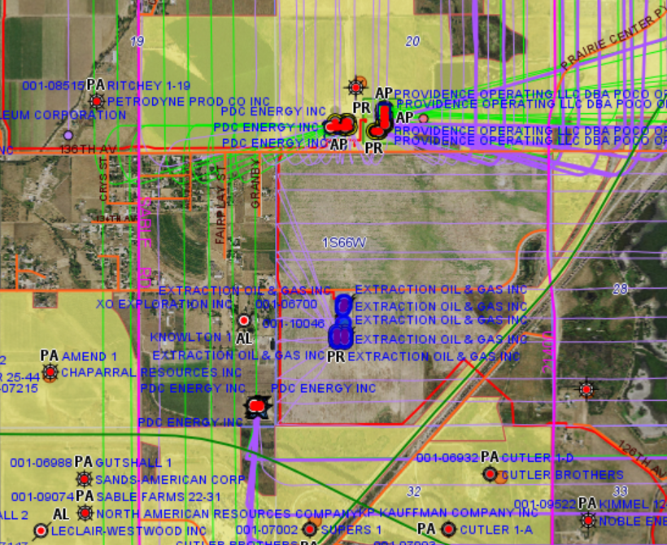
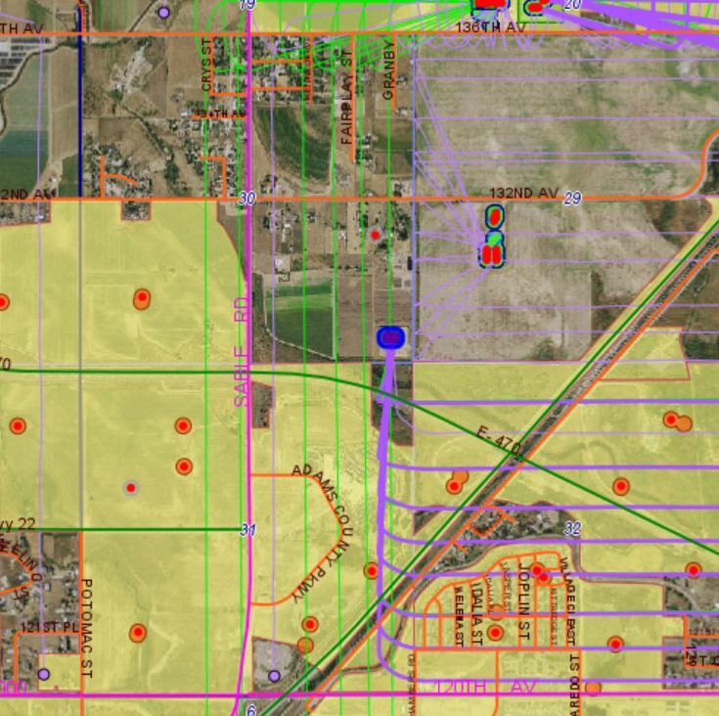
Oil and Gas Notice Update (Maps)
PC Oil and Gas Site
Edmundson Oil and Gas Site
Blue Dots are Locations

Slide 5
Adams County Oil and Gas Updates
C3/E3 has not received any updates, outside of a response about the work-over rigging, over the time of November 10-December 10.

Slide 6
CDPHE Air Pollution Control Division (APCD) Public Meeting Updates
CDPHE APCD is releasing two new rule concepts and holding upcoming public meetings on both with one offering for each in January.
The two rules are 1) about potential changes to emission report requirements and permit fees, and 2) potential changes to lawn and garden equipment requirements.
APCD is holding one meeting on potential changes to greenhouse gas emissions and energy management (GEMM) in manufacturing rules for GEMM 1 and 2 facilities in January.
And...The APCD will be hosting a public meeting to learn the basics of air quality compliance and enforcement in Colorado on January 21st from 1-2 p.m.
All offerings require registration at this link: Air Pollution Control Division: Public participation opportunities | Colorado Department of Public Health and Environment

Slide 7
Environmental Exceedance Report
Suncor Reporting Period:
October 15-November 15 Total Reportable Events: 5 Total # of Exceedances: 5
Date | Pollutant | Permit Limit/Condition | Maximum Reported Value | Total Exceedance
10/20/2025 | Opacity | 20% on a 6-minute rolling avg | 21% | 1%
10/28/2025 | NOx | 0.04lbs/MMBtu on 3-h rolling avg | 0.045 lbs/MMBtu | 0.005 lbs/MMBtu
10/16/25 & 11/4/25 | Cyanide | 5 ug/L | 12 ug/L | 7ug/L
11/10/2025 | Opacity | 20% on a 6-minute rolling avg | 24% | 4%
11/10/2025 | Regenerative Thermal Oxidizer (RTO) Temperature | RTO Temp must be at or above 1573 degrees Farenheit | 1550 degrees F | 23 degrees F
Suncor Full Report: Environmental Reportable Tier 3 Events Summary - October 15 – November 15, 2025

Slide 8
Thank you. Questions?

